Slide 1
Arduino Final Project
EE120
Tyler Burfield, Hannah Siegel

Slide 2
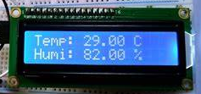
Prototype Functionality
The functionality of the prototype is to turn on a fan based on the current temperature (°C) and humidity. Using an DHT11 humidity and temperature sensor, it reads the current temperature and humidity and displays it on the LCD. If the temperature reads hotter than 20°C and more than 10% humidity, the fan will run. The fan has different speeds, which vary on the current temperature (we take the threshold temperature, 20°C, and subtract it from the current temperature). The RGB LED lights up when the fan is running, and changes colors between blue, green, and red, based on how fast the fan is running.

Slide 3
Inputs/Outputs
Temperature/Humidity Sensor | Input
LCD | Output
DC Motor | Output
RGB LED (bluePin, greenPin, redPin) | Output

Slide 4
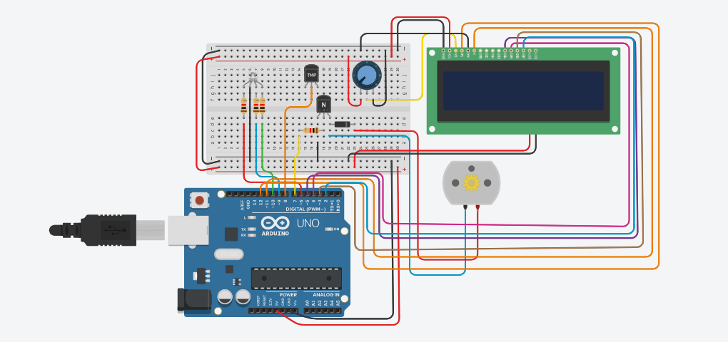
Prototype Circuit Schematic

